Slide 1


Introduction to GitHub Copilot
AI-Powered Code Assistance for Developers
Notes:
“Alright, welcome everyone! I hope you're all ready to talk about something that might just change the way you code forever.” – that was written by GithubCopilot
Now, let’s be honest—how many of you have spent way too much time Googling ‘how to center a div’ or ‘why is my SQL query slow’… only to copy-paste the first Stack Overflow answer without actually understanding it?
Well, imagine if instead of switching tabs all the time, you had an AI buddy right inside your IDE, suggesting code as you type. That's what Copilot does.

Slide 2


01 Introduction to CoPilot
02 When to use CoPilot
03 Best Practices
04 Summary
Contents
Notes:
So today, we’re going to go through what Copilot is, how it works, when you should (and shouldn’t) use it, and some best practices to make sure it helps rather than hinders your coding skills. Alright, let’s start.

Slide 3

Introduction
01

Slide 4

What is GitHub Copilot?
AI-powered code completion tool developed by GitHub and OpenAI.
Released in October 2021.
Initially based on GPT-3, now powered by GPT-4.
Notes:
So, let’s start with the basics.
What is GitHub Copilot? In short, it’s like an AI-powered autocomplete on steroids. But instead of just suggesting variable names, it can generate entire functions, debug your code, and even write comments and documentation for you.
The idea is simple: less time on repetitive tasks, more time on real problem-solving.
Think of Copilot like a junior developer who never sleeps, never complains, and sometimes makes weird coding decisions that you have to fix.
It’s designed to help, but—just like a real junior dev—you still need to review its work.
Copilot isn’t magic—it’s just really good at predicting what you will need next.
It works by looking at:
Your current file and code structure.
Your comments (yes, actual human-readable comments help Copilot make better suggestions).
The patterns it has learned from tons of open-source repositories.
What does this mean in practice? You start typing a function name like calculate_discount, and boom—Copilot suggests a full implementation. Sometimes it's perfect, sometimes it's completely off—but either way, it saves time.
Think of it like having an overenthusiastic intern. It wants to help, but sometimes you’ll look at what it wrote and say, ‘Okay… not quite what I meant, but thanks for the effort.

Slide 5
Brief history of CoPilot
June 2021: GitHub Copilot announced as a technical preview, developed with OpenAI (Codex model).
June 2022: Official launch as a paid subscription ($10/month or $100/year). Free for students and open-source contributors.
July 2022: Copilot contributes to 40%+ of code written by developers using it.
February 2023: Copilot for Business introduced with enterprise-friendly features.
March 2023: Launch of Copilot X with GPT-4:
Chat-based coding assistance
Documentation generation
Deeper IDE integrations.
September 2023: Surpassed 1 million paid users.
Notes:
Alright, a quick history lesson, because every great tool has an origin story.
June 2021: GitHub announces Copilot as a preview, and developers either love it or fear it.
In 2022: Official launch as a paid product, because of course, good things aren’t free and in few months Copilot is now responsible for 40% of code written by developers using it
In 2023 GitHub introduces Copilot X, powered by GPT-4, making it even smarter. Even saw now that the new o1 model is can be used in Visual studio code.
September 2023: Over 1 million paid users—which is wild, considering how skeptical people were at first.

Slide 6
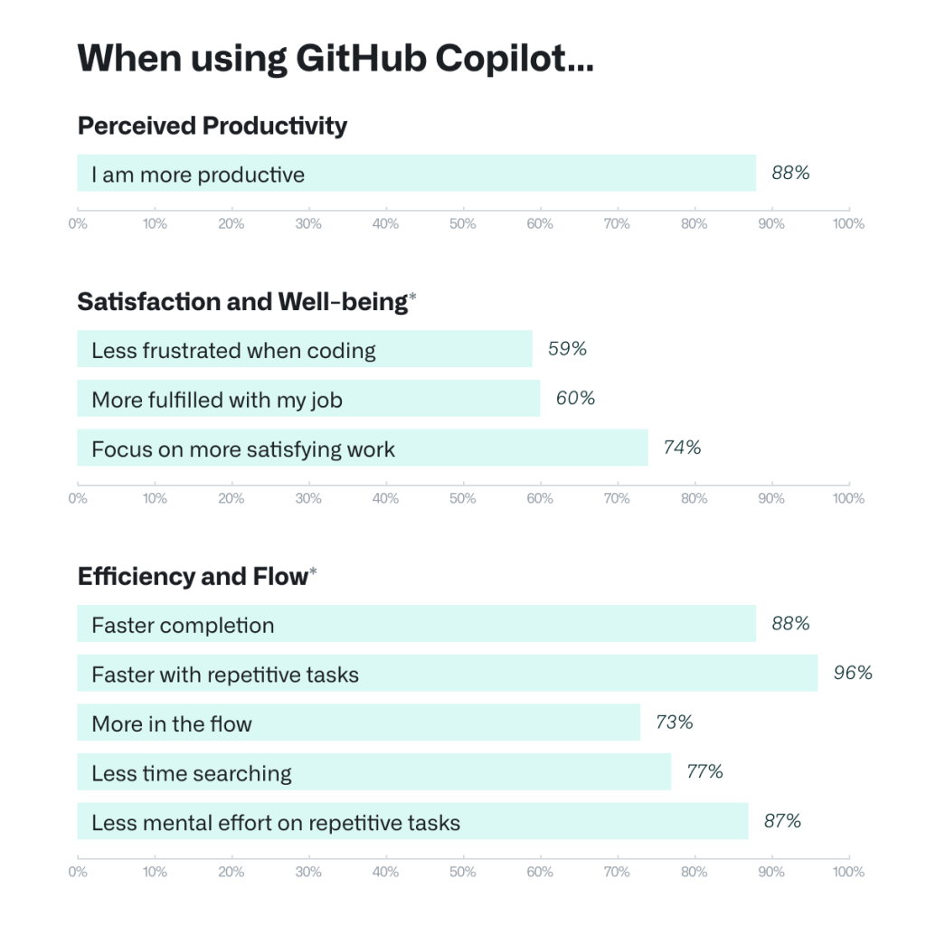
Boosting Developer Happiness and Energy with GitHub Copilot
Enhanced Developer Satisfaction:
60–75% of users feel more fulfilled in their jobs.
Reduced frustration and enhanced
ability to focus on satisfying tasks.
Conservation of Mental Energy:
73% of developers felt they could stay in the flow.
87% preserved mental effort during repetitive tasks.
Notes:
Let’s talk about something important: developer happiness.
60–75% of users say Copilot makes their jobs more enjoyable.
73% report staying in the flow longer.
87% say it reduces mental fatigue on repetitive tasks.
It’s like having a coffee machine for your brain—it keeps you moving forward without draining all your energy.
But of course, just like coffee, too much reliance on it and you start making mistakes.

Slide 7
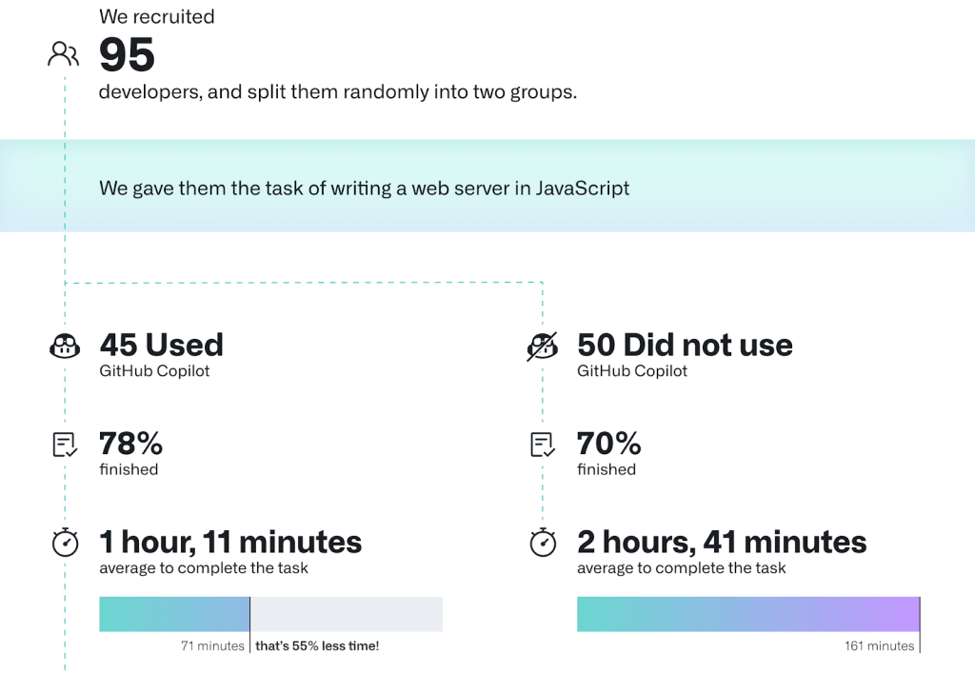
Efficiency Gains with GitHub Copilot
Faster Task Completion:
Developers completed tasks 55% faster using GitHub Copilot.
Task completion rate increased
from 70% (without Copilot)
to 78% (with Copilot).
Notes:
Now, let’s talk numbers.
Developers complete tasks 55% faster with Copilot.
Code completion rates jump from 70% (without Copilot) to 78% (with Copilot).
That’s a pretty big deal. Imagine shaving off hours of work every week. That means more time for real engineering, or, you know, scrolling Twitter—I mean, doing important research.

Slide 8
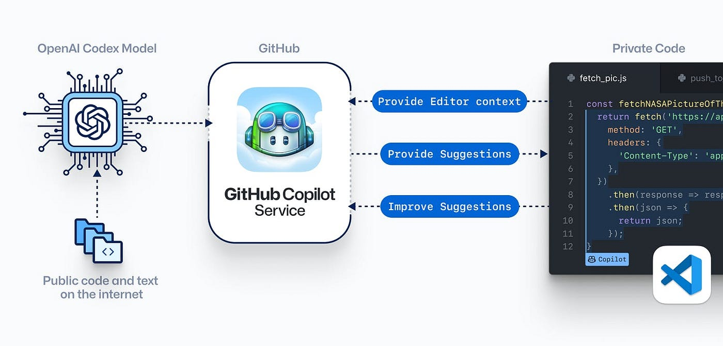
How GitHub Copilot Works
Trained on a vast dataset of open-source code and natural language.
Provides suggestions based on:
Your current file and coding environment.
Comments and code structure.
Can suggest:
Individual lines.
Methods.
Entire blocks of code.
Notes:
Copilot is not just copy-pasting from Stack Overflow.
It has been trained on millions of public repositories, so it learns patterns and suggests code based on context.
But here's the catch: it doesn’t understand what your code actually does.
It’s making statistical guesses, not thinking like a human. That means: ✔️ It’s great for boilerplate code. ❌ It can sometimes make very confident mistakes.

Slide 9

Features and Capabilities
You can use CoPilot to:
Get code suggestions as you type in your IDE
Chat with Copilot to ask for help with your code
Ask Copilot for help using the command line
Generate a description of the changes in a pull request (Copilot Enterprise only)
Create and manage collections of documentation, called knowledge bases, to use as a context for chatting with Copilot (Copilot Enterprise only)
CoPilot is available:
In your IDE
In GitHub Mobile, as a chat interface
In Windows Terminal Canary, through the Terminal Chat chat interface
On the command line, through the GitHub CLI
On the GitHub website
Notes:
"Alright, let’s talk about what GitHub Copilot can actually do for us as developers. "
1. Code Suggestions in Your IDE
*"Copilot suggests code as you type, from single lines to entire functions.
Example: Start typing def fetch_data(url): → Copilot instantly suggests a full function. No more boilerplate!"*
2. Chat with Copilot for Coding Help
*"It’s like having Stack Overflow inside your IDE—no need to switch tabs.
Example: "How do I write a recursive Fibonacci function?" → Copilot gives an instant code snippet."*
3. Get Help with the Command Line
*"Forget memorizing obscure terminal commands. Just ask Copilot!
Example: "How do I generate an SSH key for GitHub?" → Copilot walks you through it."*
4. Auto-Generate Pull Request Descriptions (Enterprise Only)
"Ever struggle with PR descriptions? Copilot summarizes your changes for you—so you don’t have to write ‘Fixed stuff’ again."
5. Knowledge Bases for Teams (Enterprise Only)
*"Teams can train Copilot on internal documentation, so it can answer project-specific questions.
Example: "How does authentication work in this project?" → Copilot gives an answer based on team docs."*
🔹 Where Can You Use Copilot?
✔️ In Your IDE ✔️ On GitHub Mobile (Chat interface) ✔️ In Windows Terminal Canary (For CLI commands) ✔️ On the Command Line (GitHub CLI) ✔️ On GitHub’s Website (PR descriptions, commit messages)
"Basically, wherever you code—Copilot is there!"

Slide 10





Supported IDE’s
Jet Brains
VS Code
Visual Studio
Neovim
Codespaces
Notes:
Good news—it works with: ✔️ JetBrains (IntelliJ, PyCharm, WebStorm) ✔️ VS Code ✔️ Visual Studio ✔️ Neovim ✔️ GitHub Codespaces

Slide 11

When to use CoPilot
02

Slide 12
When to Use GitHub Copilot
Code Generation: Quickly write boilerplate code, repetitive tasks, or standard templates (e.g., CRUD operations).
Learning and Experimentation: Explore new programming languages, frameworks, or libraries with AI suggestions.
Rapid Prototyping: Accelerate the creation of prototypes and MVPs.
Documentation Writing: Assist in generating in-line code comments and documentation.
Code Reviews: Improve existing code with suggested refactoring and optimization.
Debugging: Leverage AI-powered suggestions to identify and fix issues more efficiently.
Notes:
So, when should you actually use Copilot? It’s a powerful tool, but not every coding task needs AI assistance. Let’s break it down."
Code Generation – Automate the Repetitive Stuff
"Writing the same boilerplate code over and over? CRUD operations, API calls, basic loops—Copilot handles that so you can focus on the logic that actually matters."
Learning and Experimentation – Exploring New Tech
"Trying out a new language or framework? Copilot suggests syntax and best practices, helping you get started faster without digging through documentation."
Rapid Prototyping – Speed Up Development
"Need to get an idea into code quickly? Copilot helps build rough drafts, so you can iterate on your MVP without getting stuck in the details."
Documentation Writing – Because Nobody Likes Writing Comments
"Let’s be real—writing documentation is a chore. Copilot can generate function docstrings and comments, making your code easier to understand without extra effort."
Code Reviews – Improving Existing Code
"Copilot can suggest refactoring, optimizations, and cleaner logic, making your code more efficient before it even reaches review."
Debugging – Fixing Errors Faster
"Stuck on a bug? Copilot suggests fixes based on context, saving you from endless trial and error."

Slide 13

Scenarios Where Copilot Might Not Be Ideal
Highly Sensitive Code: Avoid using Copilot for proprietary algorithms or confidential code.
Complex Problem-Solving: Copilot might struggle with intricate or non-standard solutions requiring deep context.
Lack of Specific Context: Generates inaccurate suggestions when provided vague prompts or incomplete information.
Legal Concerns: Be cautious about licensing and copyright implications of generated code.
Over-Reliance: Using Copilot excessively might hinder deep learning of programming concepts.
Niche or Rare Use Cases: Limited effectiveness in handling less-documented technologies or unique coding patterns.
Notes:
Alright, we’ve talked about where Copilot shines, but it’s not a magic bullet. There are cases where you shouldn’t rely on it too much—or at all. Let’s go through them."
Highly Sensitive Code – Keep Proprietary Code Secure
"Copilot is great for generic tasks, but you don’t want to use it for proprietary algorithms or confidential business logic. AI-generated code could be influenced by public datasets, and you don’t want sensitive logic accidentally leaking or being compromised."
Complex Problem-Solving – Copilot Can’t Replace Deep Thinking
"For intricate, highly specific problems—like complex machine learning models, unique cryptographic implementations, or deeply optimized performance code—Copilot may not always get it right. It’s good for structure but not for deep, nuanced solutions."
Lack of Specific Context – Vague Inputs Give Vague Outputs
"Copilot isn’t psychic. If your prompts are unclear or you’re working in a project with lots of dependencies, it might generate code that’s technically correct but contextually useless."
Legal Concerns – Be Aware of Licensing Issues
"Copilot is trained on public repositories, which means some of its suggestions might be similar to existing open-source code. Be cautious, especially in commercial projects, to avoid unintentional copyright or licensing violations."
Over-Reliance – Don’t Let Copilot Do All the Work
"If you use Copilot for everything, you might end up writing code without understanding it. It’s a great assistant, but it’s still important to develop problem-solving skills and critical thinking."
Niche or Rare Use Cases – Limited Effectiveness for Uncommon Tech
"If you’re working on highly specialized, experimental, or under-documented technologies, Copilot might not be as helpful. It works best with well-established languages and frameworks."

Slide 14

Best practices
03

Slide 15



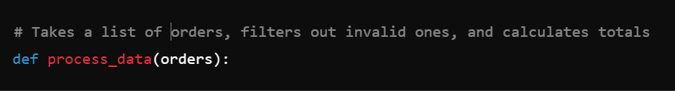

Best Practices and Tips for Better Use
Be Specific: Provide clear and detailed prompts to improve suggestions.
Verify Code: Always review and test AI-generated code for accuracy and security.
Pair with Documentation: Combine Copilot’s suggestions with official documentation for better outcomes.
Use Incrementally: Start with small tasks to build trust in its suggestions before scaling up.
Iterate and Refine: Use the AI as a collaborator and refine suggestions as needed.
Stay Updated: Regularly update the Copilot extension and explore new features.
Use in Complementary Scenarios: Pair Copilot with other tools like linters and debuggers for optimal performance.
Notes:
Alright, so we know Copilot can be a fantastic assistant, but like any tool, it’s only as good as how you use it. If you just accept every suggestion blindly, your codebase will quickly turn into a horror movie—and not the good kind.
So, here are some best practices for using Copilot:
1. Be Specific
Copilot is like that friend who’s willing to help but needs very clear instructions. The more context you provide, the better its suggestions will be.
Give it hints! It’s not a mind reader—it’s just really good at pattern matching.
2. Review Everything It Generates
Copilot might look confident, but so does a bad Stack Overflow answer.
Always review, test, and verify what Copilot writes, especially in critical systems.
3. Use It as a Partner, Not a Crutch
Copilot should help you code and do repetitive task, not replace your thinking process.
4. Pair It with Official Documentation
Copilot is trained on open-source code, not always official documentation. That means it can sometimes suggest outdated or insecure methods.
Before shipping anything to production, cross-check with official docs.

Slide 16
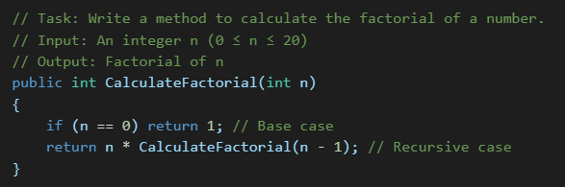
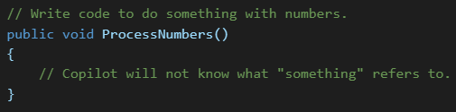
Be specific
Be Specific: Clearly define the task you want Copilot to perform.
Provide Context: Include relevant details like input, output, and constraints.
Use Comments: Add clear comments to guide Copilot’s suggestions.
Iterate: Refine prompts based on the suggestions Copilot provides.
Focus on Readability: Write concise and descriptive code comments.
Avoid Vague Prompts: Generic requests lead to irrelevant or incorrect suggestions.
Don’t Skip Context: Lack of details results in incomplete or unclear outputs.
Avoid Overloading: Writing overly long prompts can confuse the AI.
Minimize Noise: Avoid irrelevant comments or unnecessary complexity.
Don’t Assume AI Knows Everything: Copilot is not a substitute for understanding your code.
Notes:
This one’s important, so let’s go deeper:
If you give Copilot vague inputs, you’ll get vague (and sometimes ridiculous) outputs.
What Works Well?
✔️ Clearly defined function names. ✔️ Short but descriptive comments. ✔️ Giving examples of inputs and expected outputs.
What Doesn’t Work?
❌ Leaving everything up to Copilot. ❌ Accepting suggestions without tweaking. ❌ Writing unclear or inconsistent comments.

Slide 17
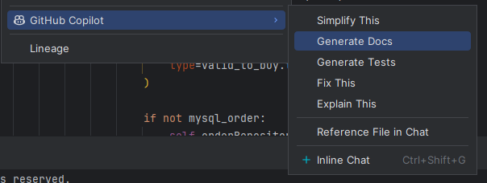
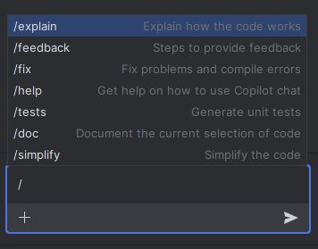
IDE functionalities in depth
Simplify This:
Used to refactor or simplify the highlighted code to make it cleaner or more concise without changing its functionality. Helpful for improving code readability and maintainability.
Generate Docs:
Automatically generates documentation or docstrings for the selected function, class, or code snippet. It ensures your code is well-documented for others or for future reference.
Fix This:
Identifies and fixes errors or issues in the selected code. This is particularly useful for debugging or handling common mistakes.
Explain This:
Provides an explanation of the selected code snippet. It’s great for understanding code, especially when working with unfamiliar codebases or learning new patterns.
Reference File in Chat:
Allows referencing a file in the chat to discuss it in the context of GitHub Copilot Chat. Useful for asking specific questions or collaborating on the file.
Inline Chat:
Enables inline communication directly within the IDE. You can interact with GitHub Copilot in real time to get suggestions, clarify logic, or iterate on code improvements.
Notes:
Alright, Copilot isn’t just a code-completion tool—it has some really cool IDE-specific features that make life easier.
1. "Simplify This" (Code Refactoring)
You highlight a messy piece of code, and Copilot can refactor it into something cleaner.
2. Copilot can generate docstrings and function explanations automatically
Now, instead of future-you (or your teammates) wondering what the function does, Copilot documents it for you.
3. Also there is a feature"Explain This" which helps you (Understand Code Faster)
Have you ever opened a legacy project and thought, "What kind of monster wrote this?" 🤯
Copilot can explain snippets of code, which is great when working with old or unfamiliar codebases.
💡 Example: You highlight a function, hit "Explain This", and suddenly it makes sense. It’s like having an always-available senior dev who doesn’t judge you for asking dumb questions.
4. "Fix This" (Automatic Bug Fixing)
Copilot can spot and fix simple mistakes in your code. Harder ones you have to debug it yourself.
5. "Reference File in Chat" – Discussing Code in Context
*"Okay, this one is a game-changer for collaboration.
🔹 What it does: You can reference an entire file inside Copilot Chat, making it easier to discuss or ask for improvements.
💡 Example: Let’s say you’re debugging a large script and you want Copilot to review the entire file instead of just a snippet. Instead of copy-pasting chunks into chat, you can reference the file directly and ask: "Hey Copilot, can you find any inefficiencies in this script?"
It’s like having a code reviewer on demand."*
6. "Inline Chat" – Real-time AI Assistance
*"This is like having Stack Overflow built into your IDE.
🔹 What it does: Instead of switching between your editor and a browser, you can ask Copilot questions inline and get answers without breaking your workflow.
💡 Example: You could highlight a function and ask: "Hey Copilot, can this be optimized?" And Copilot will suggest a cleaner version right inside your editor.
It’s like having an AI pair programmer sitting next to you, but without the awkward small talk."*

Slide 18
Summary
04

Slide 19
Summary
Efficiency: Speeds up repetitive tasks.
Exploration: Helps learn and integrate new libraries or frameworks.
Prototyping: Enables quick drafting of ideas.
Collaboration: Acts as a smart coding assistant.
Learning: Offers insights and examples for growth.
Limited Understanding: Does not genuinely understand the code's purpose.
Context Dependency: Suggestions might lack alignment with the project’s requirements.
Quality Variance: Outputs can be inconsistent in quality and efficiency.
Ethical Concerns: Risks include potential bias and licensing issues.
Not a Substitute: Requires human oversight for security, accuracy, and compliance.
Notes:
Alright, let’s wrap things up with some key takeaways:
✅ Copilot is an AI-powered coding assistant—not a replacement for developers. ✅ It works best when you provide clear instructions and review its suggestions. ✅ It boosts efficiency. ✅ Use it for boilerplate code, learning, and refactoring, but avoid using it for proprietary or security-sensitive code. ✅ Like any tool, it’s not perfect—always test and verify its output.
At the end of the day, Copilot is like a helpful intern—it speeds up the work, but you still need to double-check its results before sending them into production.

Slide 20

questions?
questions?
questions?
Notes:
Now we’d love to hear from you! Any questions about using GitHub Copilot?

Slide 21

Next session ?
Practical Demonstration with JetBrains IDEA IDE
Brief overview of the next session: live demonstration of GitHub Copilot.
Encouragement: "Prepare your laptops and IDEs to follow along!"
Notes:
In our next session, we’ll have a live demo of Copilot in JetBrains IDEA. Bring your laptops and follow along!

